Slide 1









Whiteboardmaths.com
7
2
1
5
© 2004 All rights reserved

Slide 2
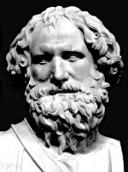
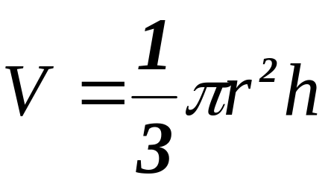
Volume of a Pyramid
In the special case, when the pyramid is a cone, the surrounding prism is a cylinder.
The volume of a pyramid is 1/3 the volume of the surrounding prism on the same base.
Archimedes of Syracuse 287 - 212 BC

Slide 3
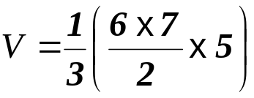
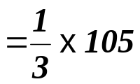
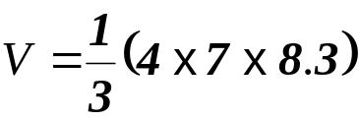


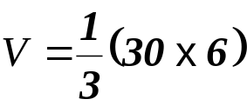

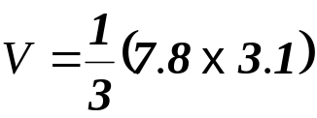

Volume of a Pyramid
Example Questions: Find the volume of the pyramids shown.
Not to SCALE
1
2
5 cm
8.3 cm
6 cm
7 cm
7 cm
4 cm
3
4
6 cm
3.1 m
30 cm²
7.8 m²

Slide 4
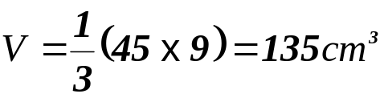
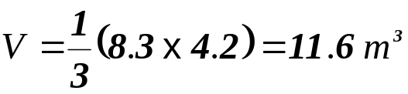
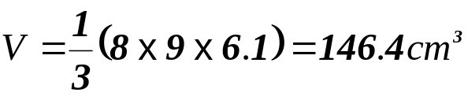
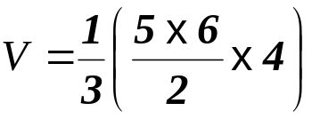
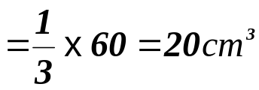
Volume of a Pyramid
Questions: Find the volume of the pyramids shown. (1 dp)
Not to SCALE
1
2
9 cm
4.2 m
45 cm²
8.3 m²
3
4
4 cm
6.1 cm
9 cm
5 cm
6 cm
8 cm

Slide 5

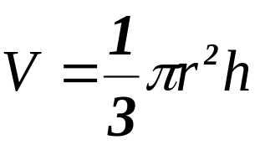
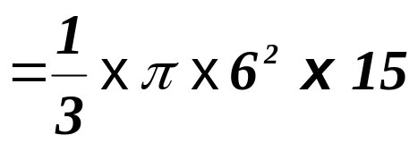
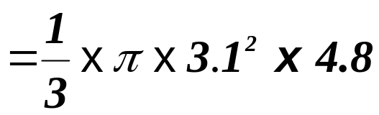


Example Questions: Find the volume of the cones below. (to 1 dp)
1
2
Not to SCALE
15 cm
4.8 cm
6.2 cm
6 cm

Slide 6
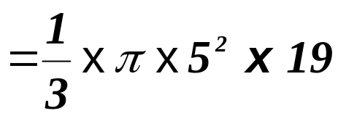
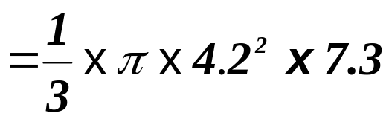


Questions: Find the volumes of the cones below. (to 1 dp)
Not to SCALE
1
2
19 cm
7.3 m
4.2 m
10 cm

Slide 7
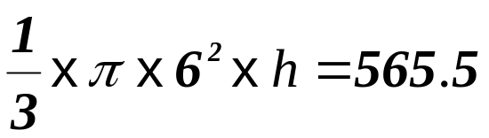
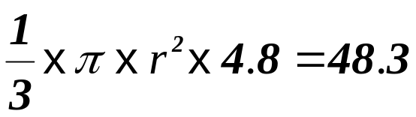


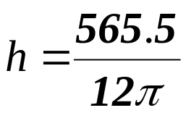
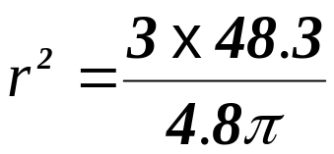

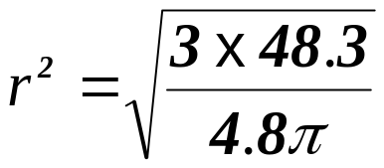

Example Questions: Find the unknown in the cones below. (to 1 dp)
Not to SCALE
3
4
h cm
V = 565.5 cm³
V = 48.3 cm³
4.8 cm
6 cm
r

Slide 8
Worksheet 1
Volume of a Pyramid
Example Questions: Find the volume of the pyramids shown.
Not to SCALE
1
2
5 cm
8.3 cm
6 cm
7 cm
7 cm
4 cm
3
4
6 cm
3.1 m
30 cm²
7.8 m²

Slide 9
Worksheet 2
Volume of a Pyramid
Questions: Find the volume of the pyramids shown. (1 dp)
Not to SCALE
1
2
9 cm
4.2 m
45 cm²
8.3 m²
3
4
4 cm
6.1 cm
9 cm
5 cm
6 cm
8 cm

Slide 10
Worksheet 3

Slide 11
Worksheet 4
h cm
V = 565.5 cm³
V = 48.3 cm³
4.8 cm
6 cm
r

